Slide 1
CONFLUENCE
SpotifAI - AI-Powered Spotify Playlist Generator

Slide 2
Problem statement and uniqueness:
Users often struggle to create personalized playlists that match their specific moods or preferences. Manually searching for and curating songs is time-consuming .
Most pre-existing playlists on spotify only have one or genres or artists at max, creating a much more complex and user friendly playlist.
So we will use AI and after taking a few prompts from the user we will create a specialized playlist exactly matching the users needs.
The most unique feature of this is the SCALABILITY of this product since we already have the base prepared we can use youtube api , amazon api to create youtube playlists or amazon shopping carts using AI.

Slide 3
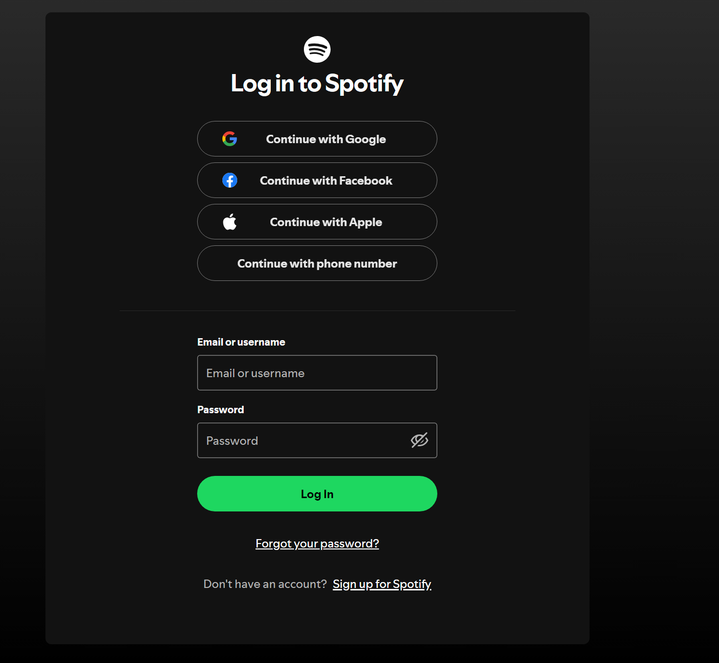
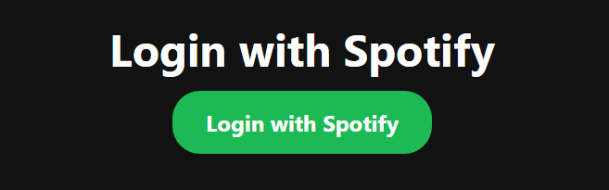
Login Page
Using SpotifyOauth we will allow the users to login to their actual spotify accounts.
It is similar to logging in to your actual spotify account(you get an OTP)

Slide 4
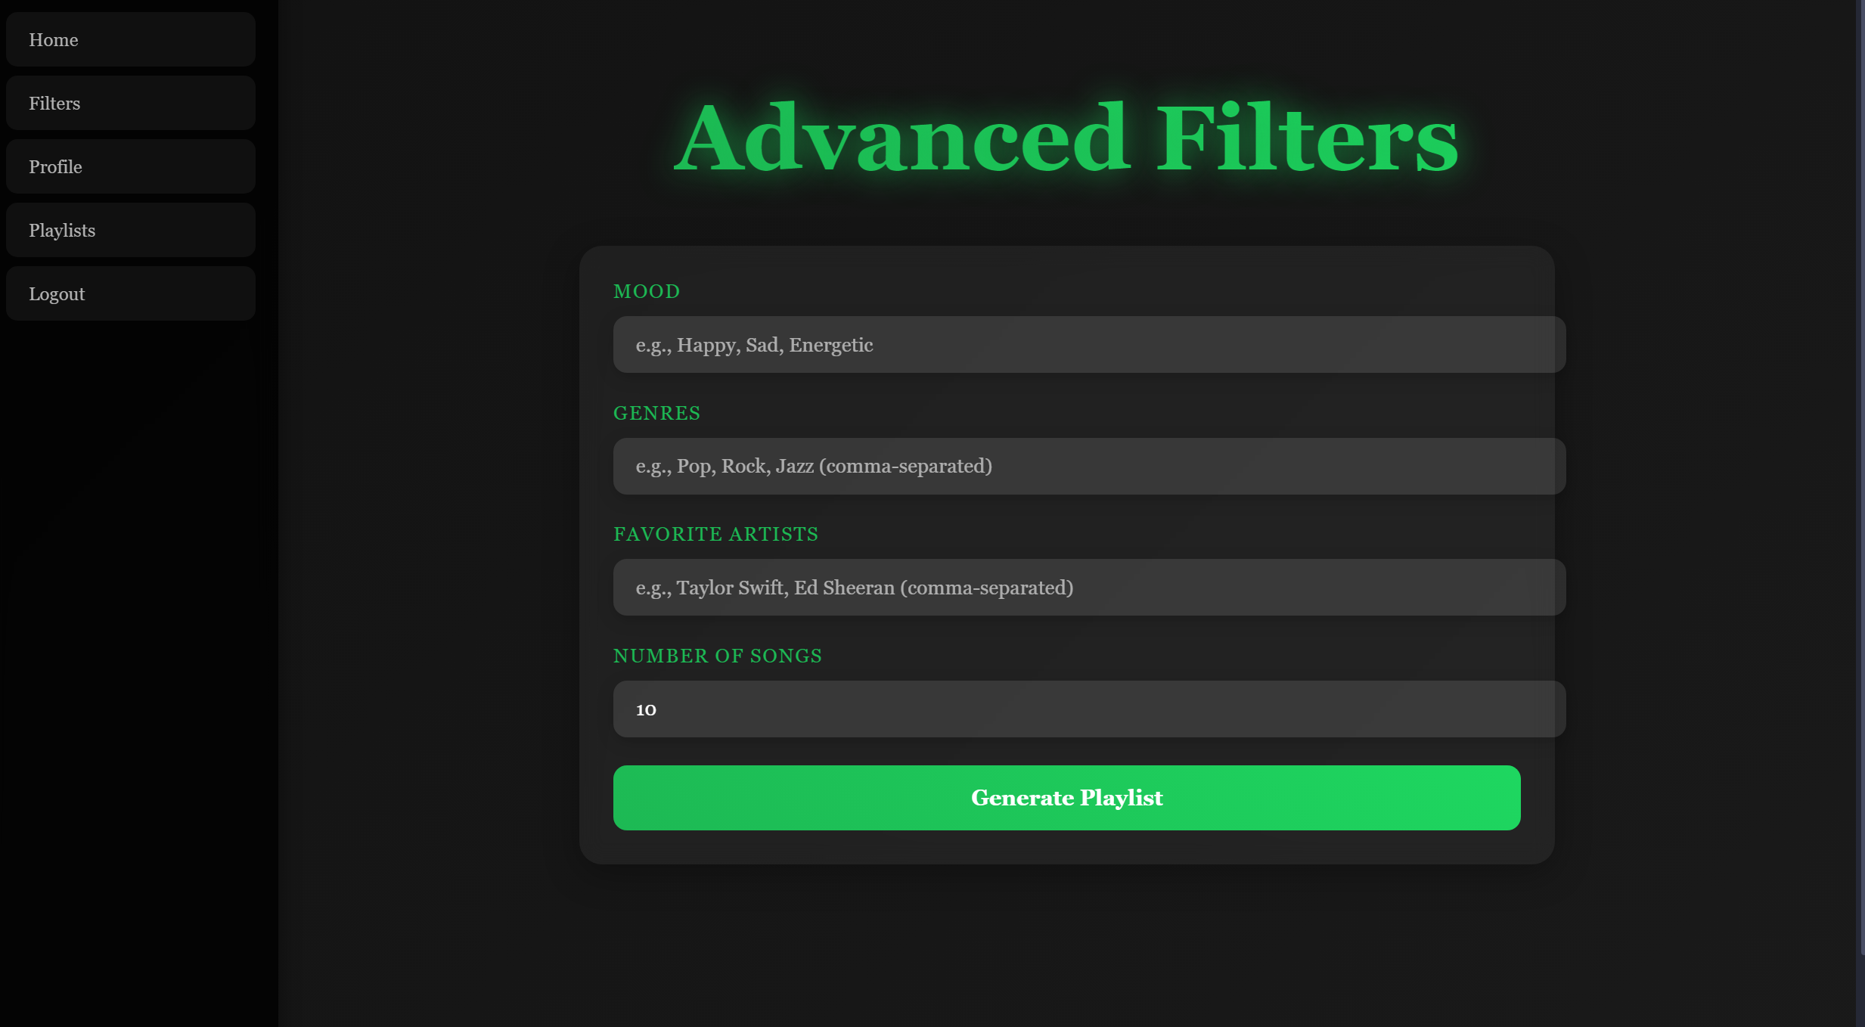
FILTER PAGE
After you successfully login we will ask the user to input a few details on what they want exactly.
These include Mood of the User, Genre the user wants to listen to, Their favourite artists (Optional) and number of songs to be added to the playlist
The side bar has multiple functions where logout will let you out of the spotify account.
The Profile and Playlist buttons will take you to their respective links in spotify web,
The filter page will reload the page.
The Home button will take you to the Home page.

Slide 5
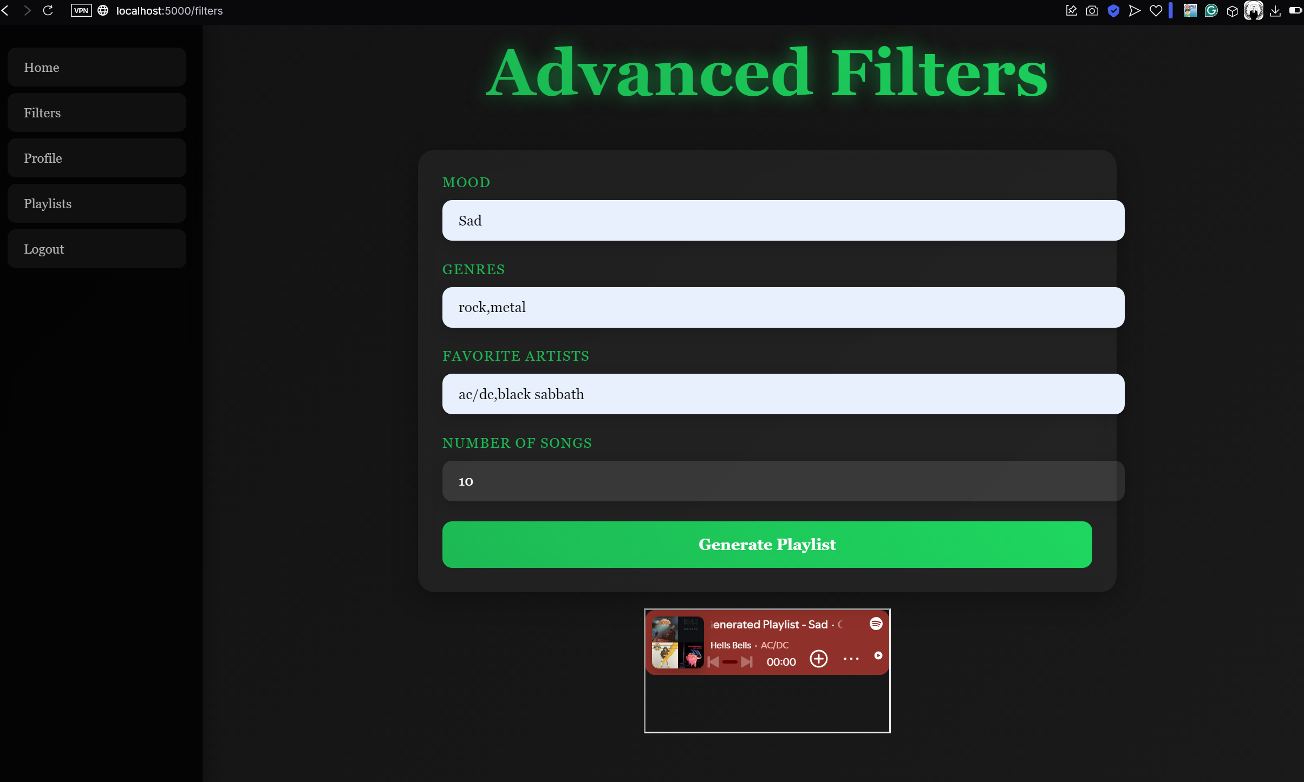
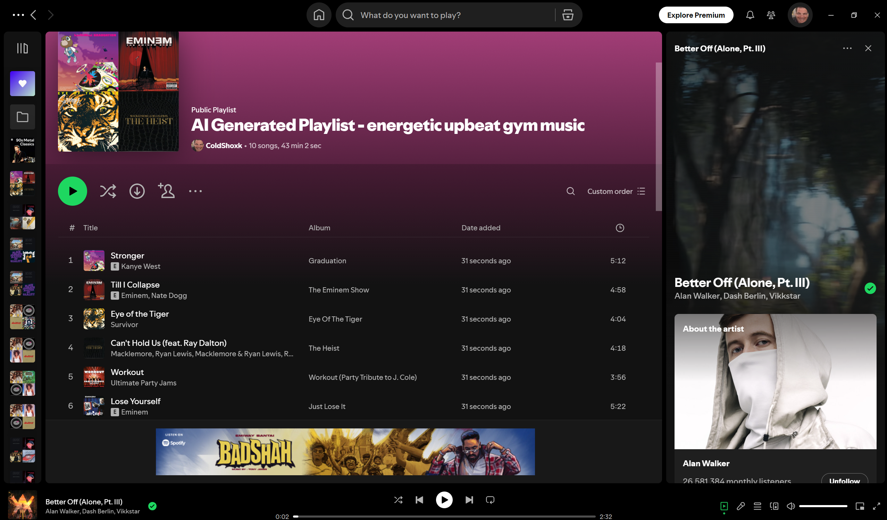
FILTER PAGE
After filling in the parameters and clicking on the generate playlist button ,The spotify embedding will take place and a small spotify playlist will be created.
Clicking on the embedded playlist will take you to spotify web under your account and you can also add the playlist to your library or play the songs right there.

Slide 6
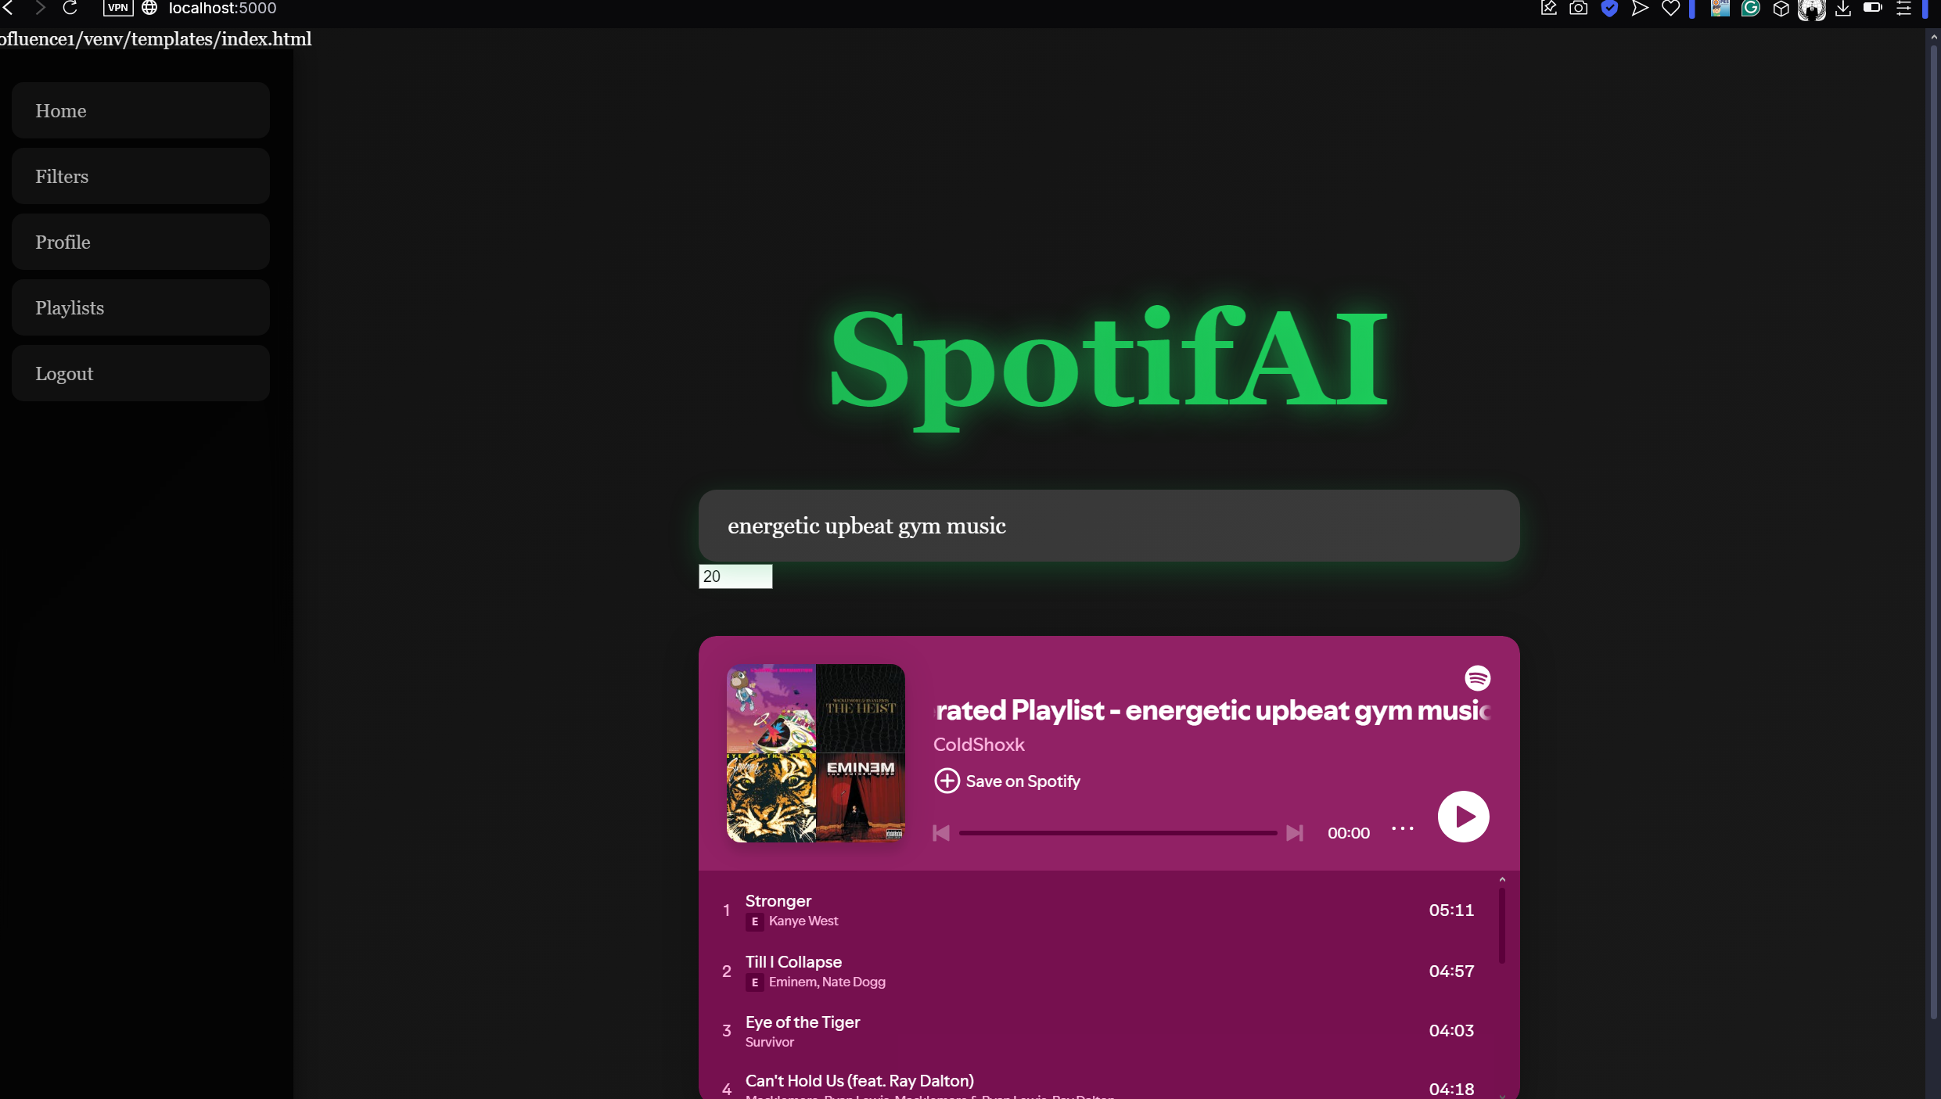
HOME PAGE
In the home page you can give any prompt you want and openai will resolve that prompt and using spotify wrapper we will create an apt playlist and display it as shown.
Similar to the filter page clicking on the embedded playlist will take you to spotify web and you can also play the songs or add the playlist to your library

Slide 7
THANK YOU

